Slide 1
Master Photo Library
Ariel Dynamics Inc.
V1.1.9.0

Slide 2
Introduction
This document describes the workflow for:
Managing the Master Photo Library
Publishing Photo Albums to the Cloud
It involves the use of two applications:
Adobe Photoshop Lightroom 4
Ariel Cloud Manager

Slide 3
Preparations
Phase I: Ready? Steady? Let’s get organized!

Slide 4
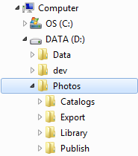
Preparations
Let’s be methodical and consistent
Let’s first examine where our photos live.
Working folder structure:
D:\Photos
Catalogs
Export
Library
Publish
Note there are 4 main subfolders

Slide 5
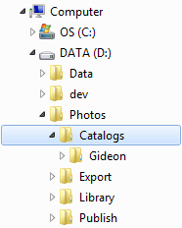
Note 1: Lightroom Catalogs
Subfolder Catalogs
Lightroom Catalogs are stored in:
D:\Photos\Catalogs
In this example, we have:
A Catalog called Gideon

Slide 6
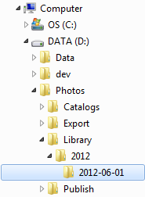
Note 2: Lightroom Library
Subfolder Library
All original photos are organized in:
D:\Photos\Library
Originals are organized
by Year and
by Date
Files are organized automatically during import in Lightroom.

Slide 7
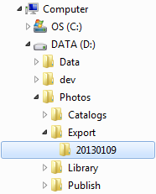
Note 3: Lightroom Export
Subfolder Export
Photos exported from Lightroom
D:\Photos\Export
Each folder maps to an online album. The example shows folder 20130109.
Note the naming convention: year, month, day. This ensures that folders are sorted old to new so they are easy to identify.
Exported photos contain all meta-data and are uploaded to GoDaddy for backup.

Slide 8
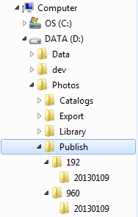
Note 4: Publish Photos
Subfolder Publish
Photos for the web are in folder:
D:\Photos\Publish
You will find multiple trees here, each optimized for a specific size.
The example shows “thumbnails” of 192 pixels, and “previews” of 960 pixels.
Files are optimized (size vs. quality) for viewing on our website and stripped of all meta-data.
Folders and files are generated and published to GoDaddy automatically.

Slide 9
Managing the master library
Phase II: Let’s ensure we file and process our original photos properly

Slide 10
Adobe Photoshop Lightroom 4
All photos are in one place
All photos are properly organized and classified
Use Adobe Photoshop Lightroom version 4.3
Step 1: import photos
Step 2: filter photos
Step 3: improve photos
Step 4: tag meta-data
Step 5: export photos

Slide 11
Lightroom: Create Catalog
Install and start Lightroom
File > New Catalog
Store it in D:\Photos\Catalogs
Called it whatever you wish, e.g. “Master Catalog” or “Gideon”
Lightroom will close and reopen the new catalog.

Slide 12
Lightroom step 1: import photos
File > Import Photos and Videos (Ctrl-Shift-I)
Configure settings
File Handling: Don’t Import Suspected Duplicates
Rename Files: GBA_yyyymmdd-hhmmss.jpg
Apply During Import: meta-data of choice
Destination: By Date, Date Format 2013/2013-01-08
Note that settings will be remembered for future imports

Slide 13
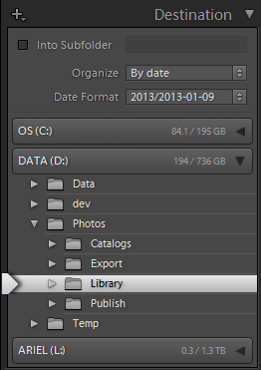
Review important settings “Import”
Verify Import Destination:
Organize: By date
Date Format: Year/Date
D:\Photos\Library

Slide 14
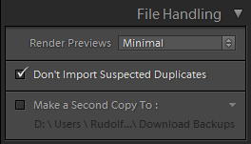
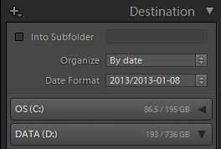
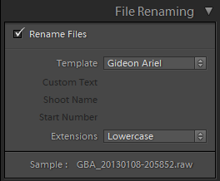
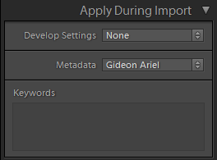
Review all settings “Import”
Render Previews: Minimal
Don´t Import Suspected Duplicates
Organize: By Date
Date Format: 2013/2013-01-08
Rename files
Template: GBA_yyyymmdd-hhmmss
Develop Settings: None
Metadata: Gideon Ariel

Slide 15
Lightroom step 2: filter photos
We will only publish “good” photos
Select Catalog > Previous Import (Library, west pane)
Purge all photos that are out-of-focus, blurred, under-exposed, over-exposed, ugly, inappropriate or otherwise unacceptable:
Photo > Set Flag > Rejected (X)
Rate photos
Photo > Set Rating > 1 Star (1)
Photo > Set Rating > 2 Star (2)
Photo > Set Rating > 3 Star (3)
If desired, we can purge rejects from the master library
Photo > Delete Rejected Photos (Ctrl-Backspace)

Slide 16
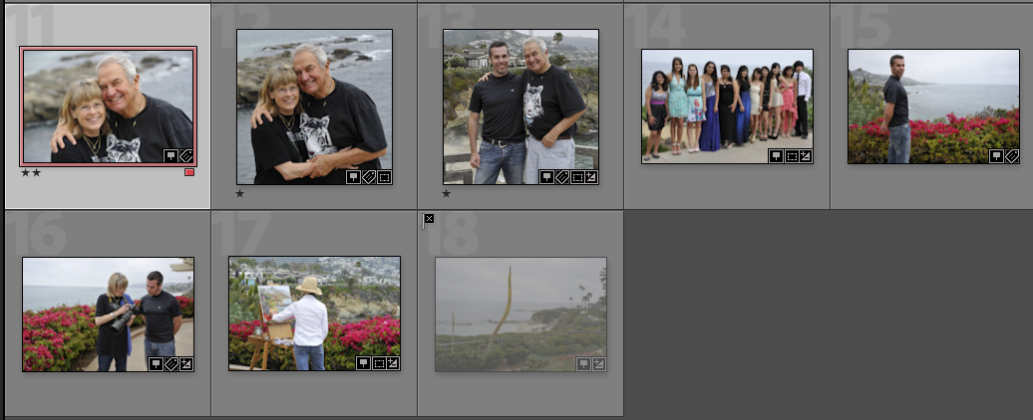
Example filter photos
Photo #1 has been rated with 2 Stars (2)
Photos #2 and #3 have been rated with 1 Star (1)
Photo #8 has been flagged as Rejected (X)

Slide 17
Lightroom step 3: improve photos
Improve photos as you see fit
Cropping
Spot Removal, Red Eye Correction, Graduated Filter
Basic corrections
Tone Curve corrections
Etc.
Note that all operations are non-destructive

Slide 18
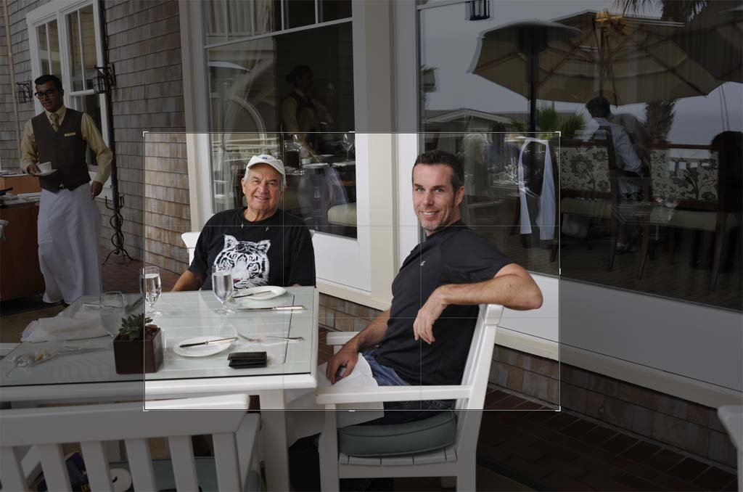
Example: cropping undesired elements

Slide 19
Lightroom step 4: tag meta-data
Select all photos to be tagged (Ctrl-A)
Under Location (east pane), input:
Sublocation e.g. “On the Beach”, “Disneyland”, “Bangkok Sports Research Center”, “C’est la Vie”,
City
State / Province
Country
Title: describe event e.g. “Trip to Europe”, “ISBS Conference”
Caption: describe contents of photo
Note that metadata may be (should be) set on multiple photos at once.

Slide 20
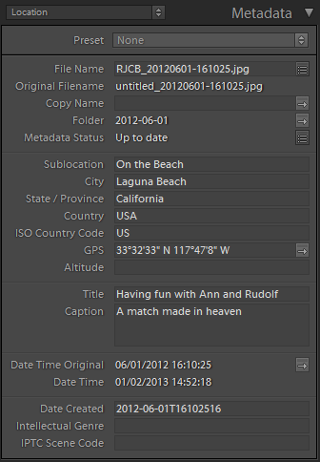
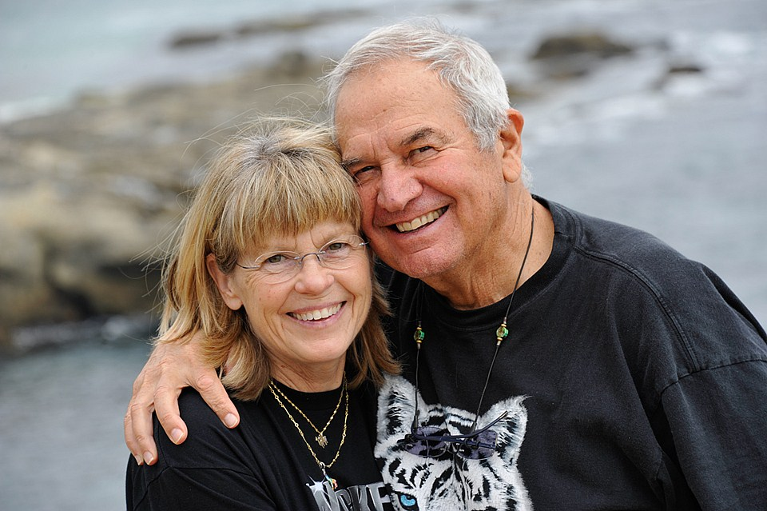
What, When, Where, Who, Why
WHERE
Sublocation
City
State / Province
Country
Title
Caption
On the Beach
Laguna Beach
California
USA
Having fun with Ann and Rudolf
A match made in heaven
WHAT
WHEN

Slide 21
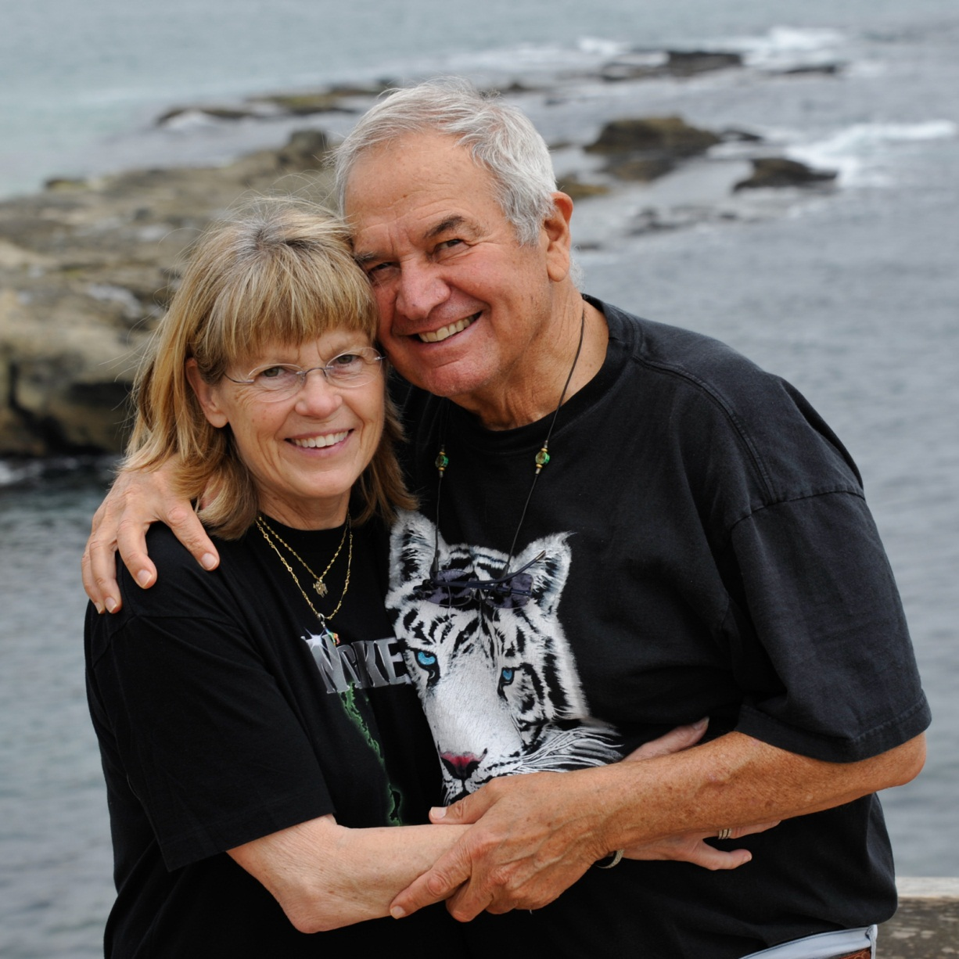
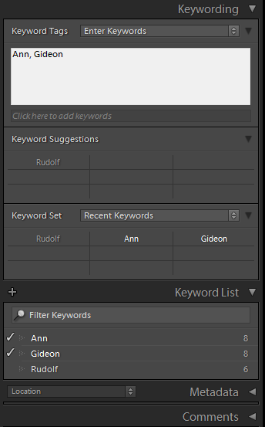
What, When, Where, Who, Why
WHO

Slide 22
Lightroom 4: exporting data
Select photos to be exported
Choose File > Export
Export Location
Folder: D:\Photos\Export\Root
Put in Subfolder: 20130101 (yyyymmdd)
File Settings: Jpeg; Q-90; sRGB
Image Sizing: Resize to Fit; Long Edge; 1600 pixels
Output Sharpening: N/A
Meta data: All, checkboxes unchecked
Settings will be remembered for future exports

Slide 23
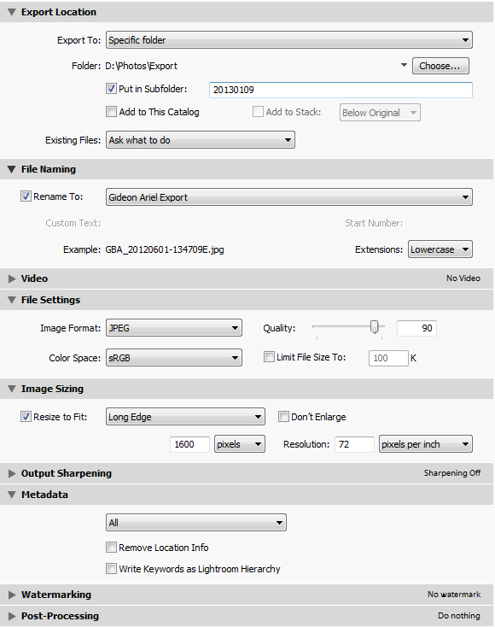
Review settings “Export”
Folder: D:\Photos\Export
Put in Subfolder: yyyymmdd
Rename to
GBA_yyyymmdd_hhmmssE.jpg
JPEG, Quality 90, sRGB
Resize Long Edge to 1600 pixels
Keep All Metadata

Slide 24
PUBLISH TO THE CLOUD
Phase III: Let’s get these local files to the cloud for the world to see

Slide 25
Ariel Cloud Manager
Start application Ariel.Cloud.Manager
Select tab Photos
Select folder
D:\Photos
Select “Publish”
Wait for it to finish
See results on the web:
www.arielnet.com/cloud/Albums/Recent/10

Slide 26
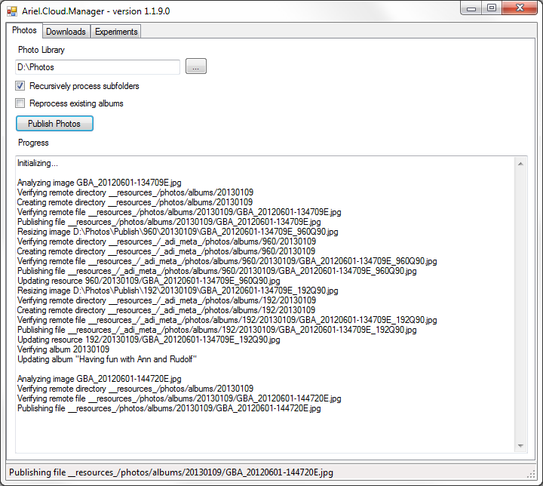
Ariel.Cloud.Manager

Slide 27
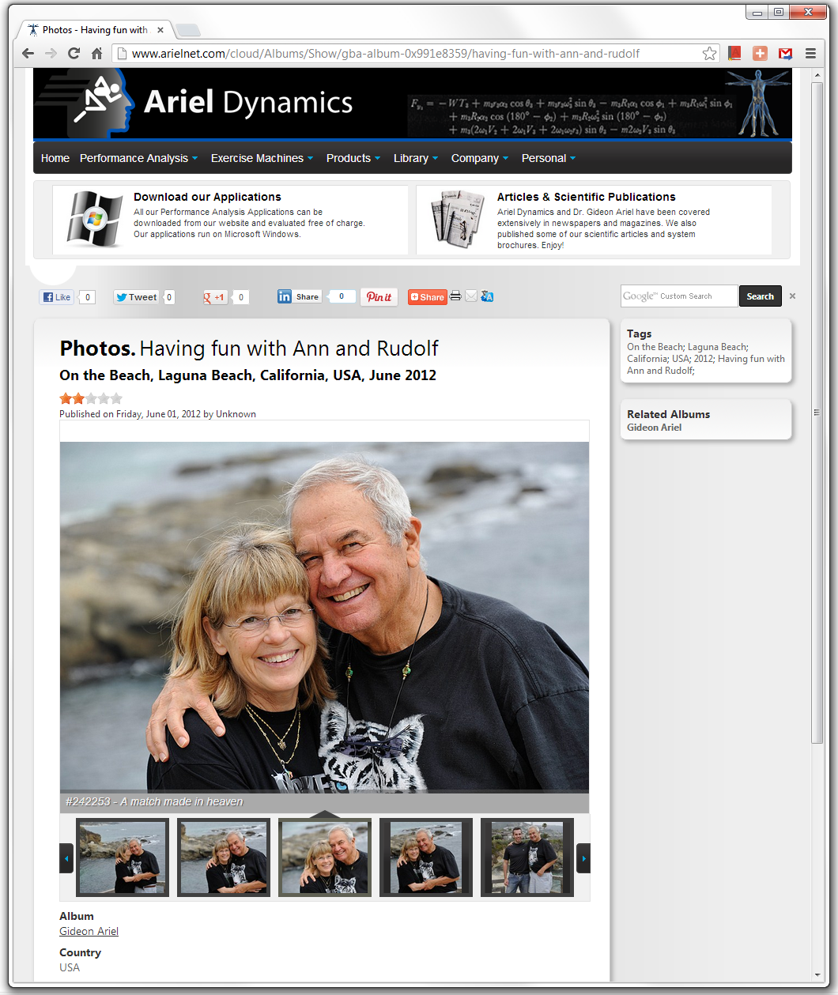
Results
After publishing, the album is online.
Note that Titles, Subtitles, and Tags have all been set automatically.
Clicking any Tag will lead you to a list of albums with that same tag, e.g. for “Laguna Beach”, “2012”, etc.

Slide 28
Conclusion

